Slide 1
AdaCore Update
Ada Europe 2019

Slide 2
The AdaCore Offer
AdaCore provides tools and technologies for the software development life cycle.
Development Tools
Static Analysis & Verification
Model-Based Engineering
Certification & Qualification
CodePeer - Static Analysis
GNATcoverage – Dynamic Analysis
Coding Standards compliance
GNATcheck
GNATmetrics
SPARK Pro - Formal Verification
GNATstack - Stack Analysis
Native/Cross toolchains
GNATPro
IDEs
GPS
GNATbench
Debugger
GDB
QGen
TQL 1 qualification
Simulink® and Stateflow®
Code generation
Model verification
DO-178
EN 50128
ECSS
ISO 26262
IEC 61508

Slide 3
Compiler updates
Support for ARM 64-bit platforms, RISC-V
Ongoing support for VxWorks 7 SR0610 through 2019, new version support for Lynx178, PikeOS
Upgrade to GCC 7 and GDB 8.2 and transition to GCC 8 and GDB 8.3 GNAT Pro 20
Working on plugging GNAT front-end with LLVM code generator
Will publish sources on GitHub Sept 2019
Will likely be used for GNAT Community on Mac OS in 2020

Slide 4
Ada 2020 implementation
Establishing a platform for interaction with the community at large
Will be available xxx
Let us know what you want!

Slide 5
GNAT Studio
GPS 19 features:
Improved stability, new learn view, improved debugger integration, improved scenario view, revamped handling of color and theme support, Libadalang view
GPS being renamed GNAT Studio for release 20
Switch to many more libadalang based services (source navigation, pretty print, outline)GNAT Studio will be 64 bits only

Slide 6
CodePeer Classifications
Types of checks that CodePeer performs
Run-time Errors
Logic Errors
Race conditions
Checks added implicitly by the compiler (index checks, range checks, division by zero, …)
Explicit Assertions, Pre/Post Conditions, Predicates and Invariants
Explicitly raised exceptions
Uninitialized variables (both global and local)
Dead code
Tests always true
Never ending loops
Suspicious implicit preconditions
Useless assignments
Unprotected access to variables in multiple tasks
Can be trained to us calls to system locks (mutex, spinlock, etc…)

Slide 7
CodePeer enhancements
New HTML interface using state of the art web technology
New user entry level: redesigned "level 0" including new checkers, enabled by default (-level 0)
Simple "getting started quickly" mode for new users without requiring any complex project set up (--simple-project)
Security report
GNATcheck integration
Improved precision and analysis time

Slide 8
GNAT Pro C and C++
 | Native (x86) |  | Embedded (PowerPC, ARM, x86)
 | Linux | Windows | Linux | Bare Metal | VxWorks 6 | VxWorks 7 | Lynx178
C
C++

Slide 9
Embedded C++ Strategy
10 new GNAT Pro C++ ports
Cross Linux ARM 64 bits (Q1 2019)
Cross Linux ARM 32 bits (Q1 2019)
Cross Linux PowerPC 32/64 bits (Q1 2019)
VxWorks 7 ARM 32/64 bits (Q1 2020)
VxWorks 7 x86 32/64 bits (Q1 2020)
VxWorks 7 PowerPC 32/64 bits (Q1 2020)

Slide 10
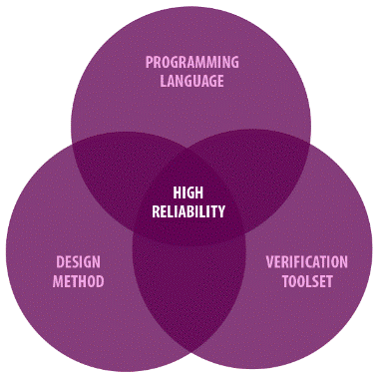
SPARK 2014 plans
Support for access types
Fine grain initialization proof
Improvements to counter-examples
ISO-26262 (Automotive) qualification

Slide 11
Why Ada ?

Slide 12
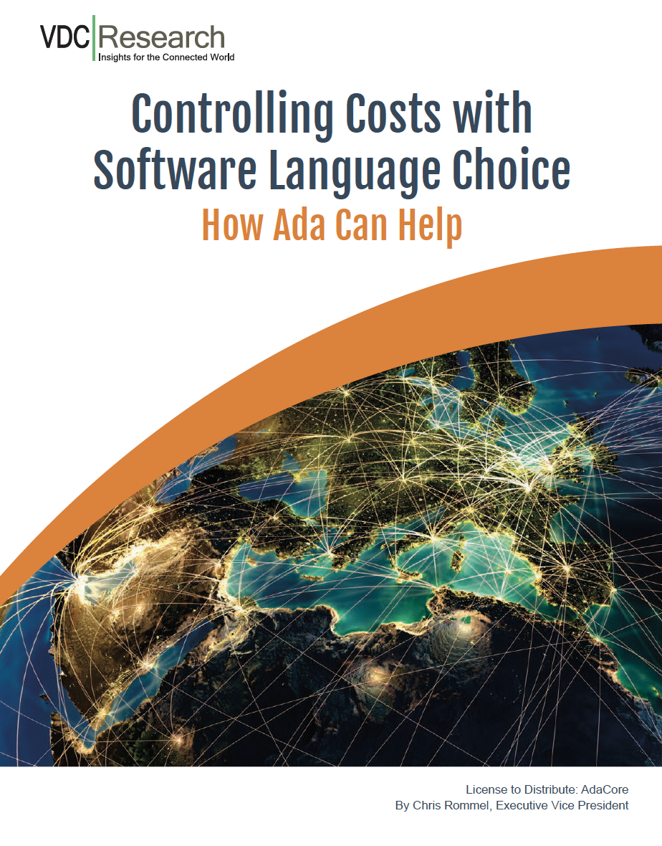
Controlling Costs with Software Language Choice

Slide 13
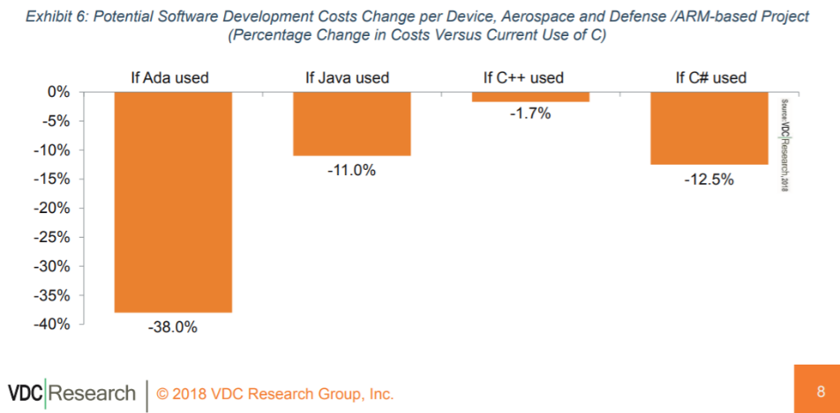
Why do they care about Ada?
Source: https://www.adacore.com/uploads/techPapers/Controlling-Costs-with-Software-Language-Choice-AdaCore-VDC-WP.PDF

Slide 14
Cyber Security
The Ada and SPARK languages have intrinsic qualities to develop cyber-security applications
Compiler hardening in development
Memory erasing
Branch hardening
Fuzz-testing

Slide 15
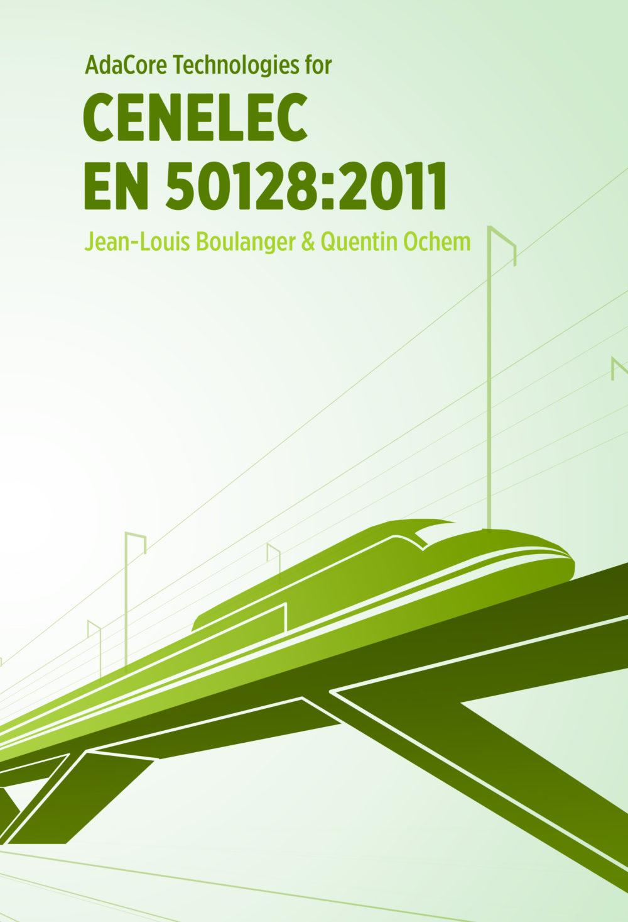
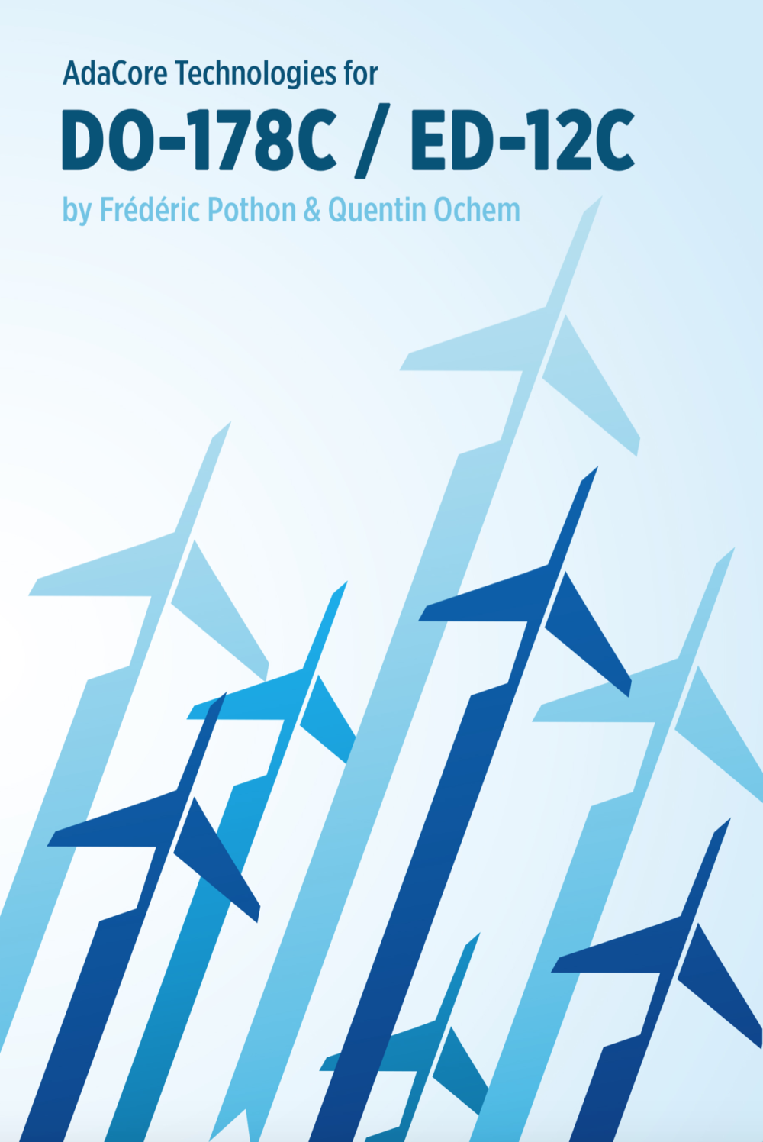
CENELEC EN 50128 & DO178/ED12C

Slide 16
Ada pedigree - Certification
8 completed certification projects (space, railway, avionics) and 6 in the pipeline
ISO 26262 certification of our Ada and C compilers for RISC V, GNAT CCG, SPARK Pro. TUV is the certification authority.

Slide 17
Same language, new markets
Mentorship services
Accompany adoption of Ada and SPARK when migrating from C
Automotive (NVIDIA)
Medical devices (Welch Allen)

Slide 18
Ada advocacy
RISC-V Foundation Membership - C and Ada compilation support for RISC-V
White paper “Ada: Meeting Tomorrow’s Software Challenges Today”
Book “SPARK Ada for the Misra C Developer”
Hex Five Partnership - Ada for Multicore Security

Slide 19
Community work
FACE
“In raising our membership level to Principal in the FACE Consortium, we will continue to participate actively in the definition of the FACE Technical Standard and ensure Ada’s role in the Safety capability sets”
Make With Ada

Slide 20
222 university members/660+ academic contacts
*Now open to PhD and Master’s students*

Slide 22
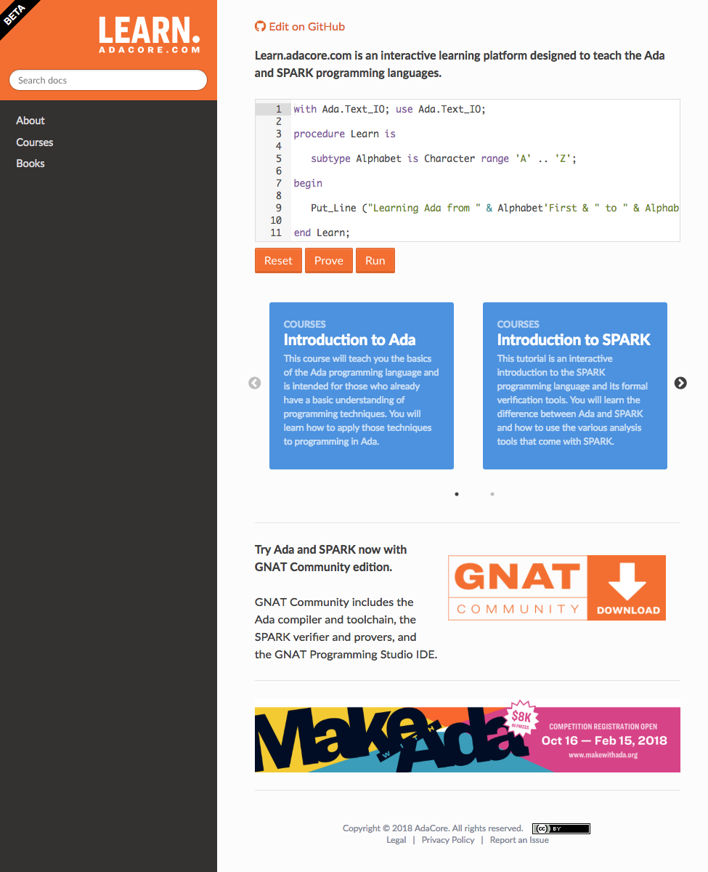
2019, adding...
3 more courses
Embedded
Advanced Ada
Advanced SPARK
Labs
Book (SPARK vs MISRA-C)

Slide 23
+

Slide 24
Expand the reach working with hardware partners (RISC-V, microsemi, …)

Slide 25
Questions ?

